Slide 1
TransBorder Freight Data Analysis.
A Deep Dive into Cross-Border Freight Trends and Recommendations.
Presented by: Isaac Owusu Akowuah

Slide 2
Title and Content Layout with List
Project Title
Table of Content
Project Overview
Objectives of the Analysis
Methodology
Data Preprocessing Steps
Dashboard Overview
Key Insights
Recommendations

Slide 3
Project Overview
Project Title: TransBorder-Freight-Data-Analysis Report
Tool Used: Microsoft Power BI
Dataset Source: Bureau of Transportation Statistics (BTS)
Time Period: Jan 2020 – Sept 2024 (missing Oct-Dec 2020)

Slide 4
Objectives of the Analysis
Main Questions:
What is the total value of goods transported?
What is the number of freight movements?
What is the most used transportation mode?
What are the trends in value over the years?
What are the top 4 U.S. states by Goods value?
How does weight vary by month and country?
What actionable insights can be derived?

Slide 5
Methodology
Approach: CRISP-DM (Cross-Industry Standard Process for Data Mining)
Business Understanding
Data Understanding
Data Preparation
Modeling & Visualization
Evaluation
Deployment & Communication

Slide 6
Data Preprocessing Steps
Combined all CSV files for Power BI import
Transformed coded categorical columns (e.g., MONTH = 1 → January)
Transformed data as coded in the dataset dictionary
Created calculated fields:
Total Value Transported = SUM(Value)
Number of Transportations = COUNT(Transportation Mode)

Slide 7
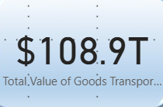
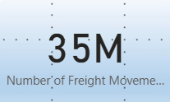
Dashboard Overview
Key Metrics (KPI Cards):
Number of Freight Movements: 35 Million
Total Value Transported:
$108.9 Trillion

Slide 8
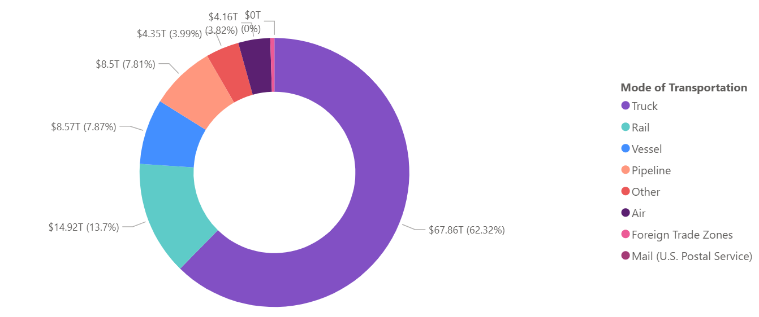
Mode of Transportation by Value
Key Insights
Truck is the dominant mode for freight transportation

Slide 9
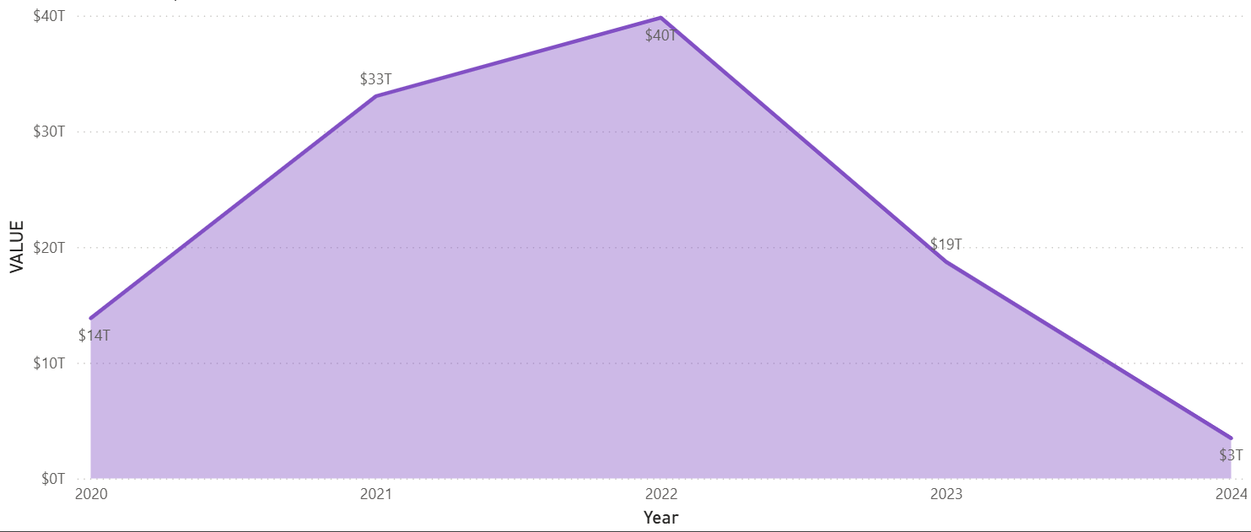
Value Trends by Year
Key Insights Cont’s
2022 had the highest value of goods transported
A noticeable decline in 2023 and 2024

Slide 10
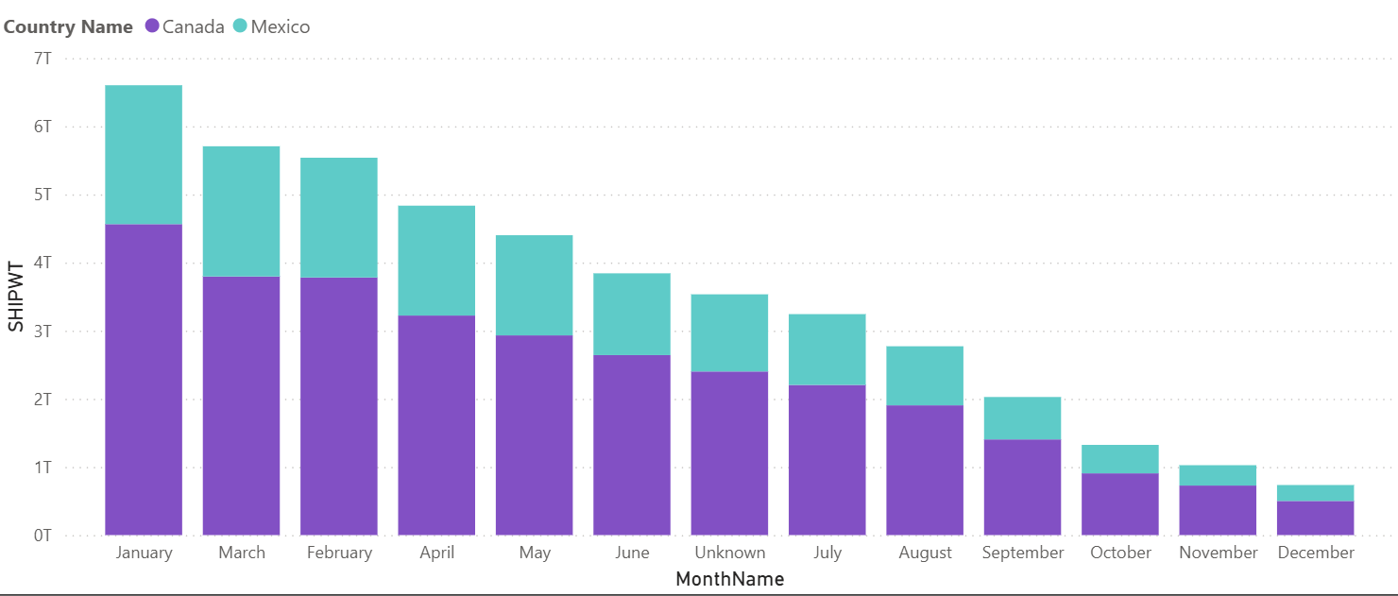
Shipping Weight by Month & Country
Key Insights Cont’d
Top Months for Weight Transported: January and March
Leading Trade Country by Weight: Canada > Mexico

Slide 11
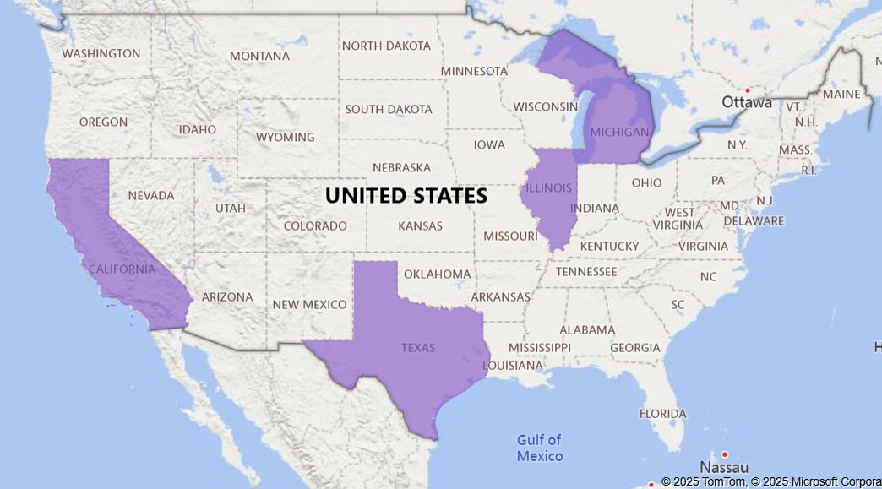
Top 4 USA State by Goods Value
Key Insights Cont’d
Top 4 States: Texas, Michigan, California, Illinois
Texas led with $15.8 Trillion in transported goods

Slide 12
Recommendations
Approach: CRISP-DM (Cross-Industry Standard Process for Data Mining)
Invest in infrastructure support for road transport: such as improving highways and border facilities.
Promote digital logistics tools: To increase trucking efficiency, promote the use of route optimization systems.
Root-cause analysis: Conduct a root-cause analysis (e.g., cost of transportation, demand decline, geopolitical disruptions).
Policy planning: Policy planning around these top states (Texas, Michigan, California, Illinois) to streamline trade corridors.

Slide 13
Recommendations Cont’d
Bottlenecks or missed opportunities: Benchmark other states against Texas to identify bottlenecks or missed opportunities.
Plan maintenance or upgrades: Plan maintenance or upgrades outside of peak months to minimize disruption.
Bilateral trade and infrastructure: Focus bilateral trade and infrastructure discussions more heavily with Canada.

Slide 14

Isaac Owusu Akowuah
Data Analyst | Power BI Developer | ML Engineer
Website | LinkedIn | GitHub
Email: ioakowuah@gmail.com

